Slide 1
Inside the Database Engine John Deardurff

Slide 2



Inside the Database Engine
John Deardurff
Website: SQLMCT.com
Twitter: @SQLMCT
June 9th, 2020

Slide 3
What does this session cover?
What is the Database Engine?
A Closer look at SQLOS
Waits and Threads
The Relational Engine
The PROCESS of a Query
The Storage Engine
Locks, Blocks, and Deadlocks

Slide 4
SQL OS: A Closer Look John Deardurff

Slide 5
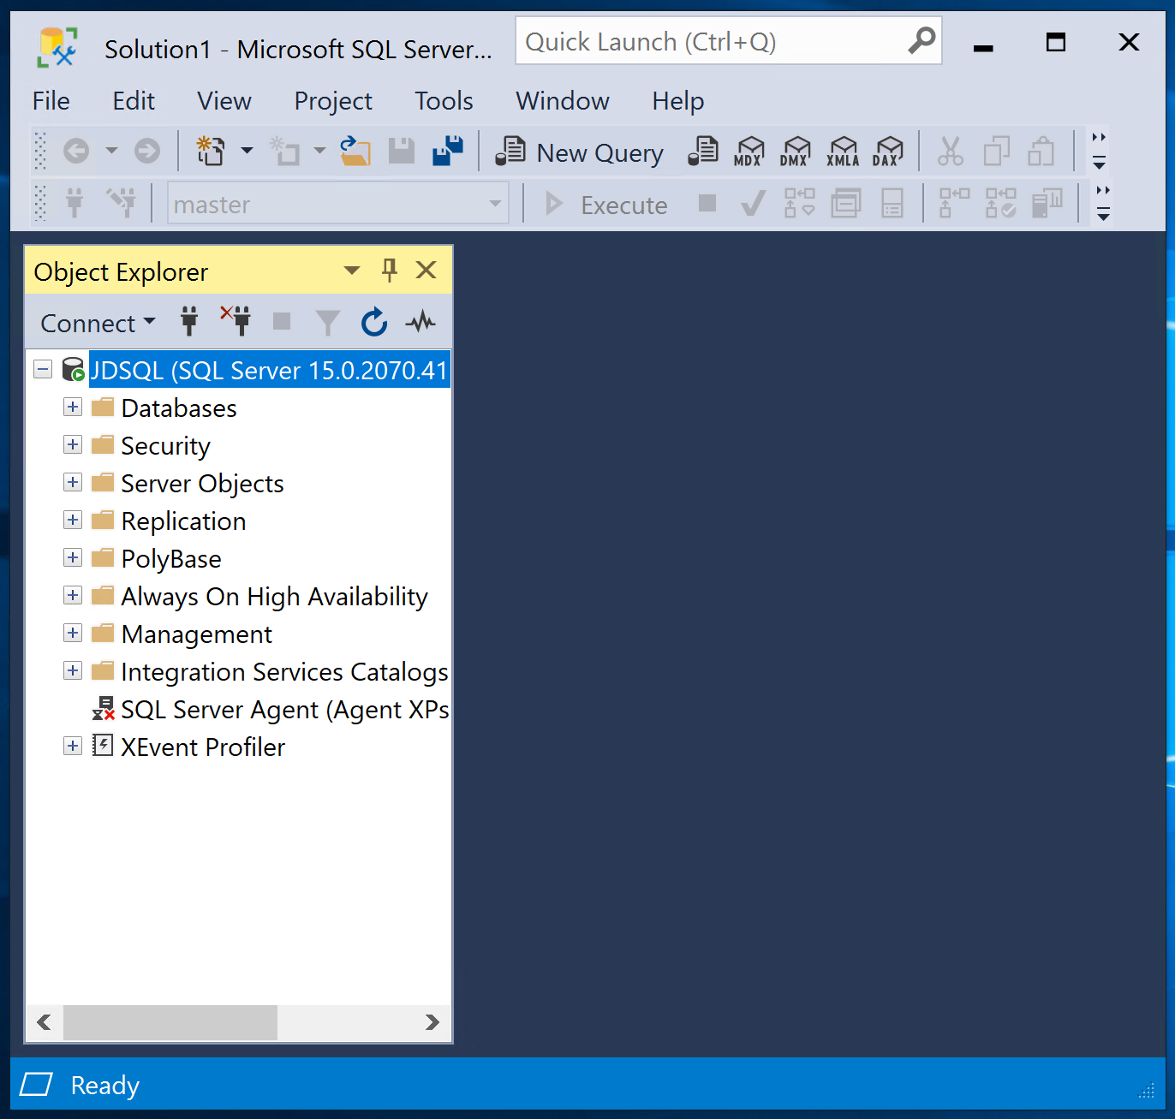
Client/Server Architecture
Relational Engine
Requests Data
SQLOS
Storage Engine
Provides Data
The Database Engine
Client
Server

Slide 6
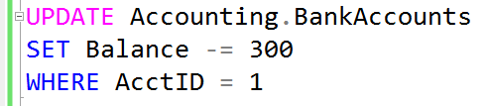

Query Process
Relational Engine
Resource Access
SQLOS
Storage Engine
Data Access
The Database Engine

Slide 7
SQLOS Provides Many Functions
Thread Scheduling
Memory Management
Transaction Management
Exception Handling
Locking Framework
Deadlock Detection

Slide 8

Data Architecture Virtual Group
https://dataarch.pass.org/
Transaction and Isolation Levels
June 11^{th,} 2020 at 2:00pm EDT

Slide 9
Locks, Blocks, and Deadlocks John Deardurff

Slide 10
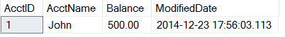

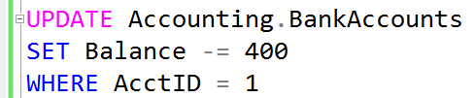
What is a Lock?
Transaction 1
Transaction 2
TSQL2012.mdf

Slide 11
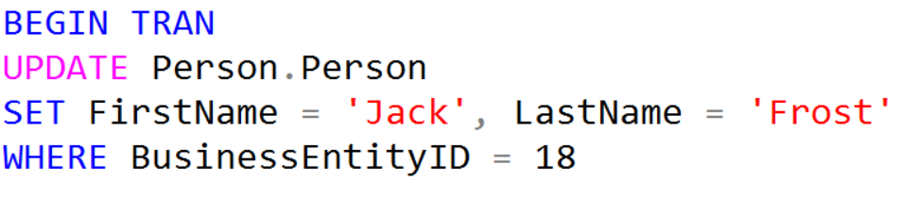
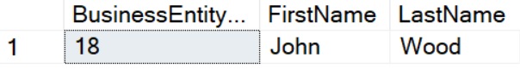

What is Blocking?
Transaction 1
Transaction 2
Blocked
TSQL2012.mdf

Slide 12
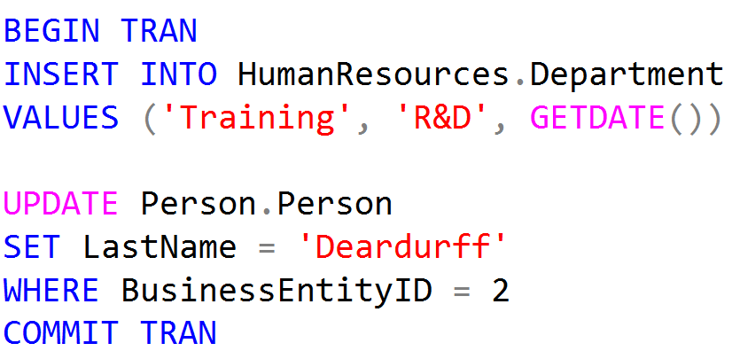
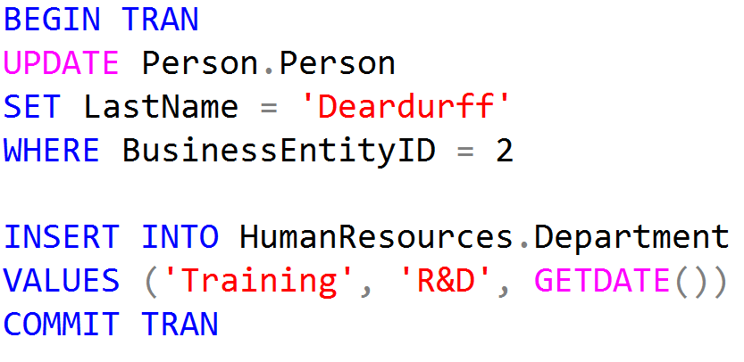
What is a Deadlock?
Person.Person
Blocked
Transaction 1
Transaction 2
Blocked
HumanResources.Department

Slide 13
Demonstration

Slide 14
Waits and Threads John Deardurff

Slide 15
Preemptive vs. Cooperative Scheduling
Windows uses Preemptive scheduling
Is driven by the view of prioritized computation
Means that a low-priority process is pre-empted out of the processor by a high-priority process
SQL Server uses Cooperative scheduling
Means that the priority of a process doesn’t matter
Is where a process is not preempted, and executes until it explicitly yields the processor
Notes:
Try not to spend too much time here. Content in later slides is more important.
Technically, Resource Governor enables some processes to be treated preemptively and take priority over a process that is running in a lower-priority resource group. However, discussing this at this point is unlikely to be helpful to students who are new to the topic. Students who have some experience of Resource Governor might raise the point.
10987B
1: SQL Server Architecture, Scheduling, and Waits

Slide 16
Thread States and Queues
Runnable: The thread is currently in the Runnable Queue waiting to execute. (First In, First Out).
Running: One active thread executing on a processor.
Suspended: Placed on a Waiter List waiting for a resource other than a processor. (No specific order).
Notes:
10987B
1: SQL Server Architecture, Scheduling, and Waits

Slide 17
SQL Server Execution Model
Runnable List
Status: runnable
CPU available
Start
CPU
Status: running
Complete
Quantum exhausted
End
Resource blocked
Waiter List
Status: suspended
Resource available
Notes:
It’s worth spending some time on this slide to make sure that the students grasp these concepts because an understanding of them is critical for the rest of this course. Try to avoid discussing wait types here because the next lesson covers the topic in detail.
10987B
1: SQL Server Architecture, Scheduling, and Waits

Slide 18
Thread Stack Memory
Maximum Worker Threads
512 + (Processors -4) *16
2MB per thread
*
Cores | Threads | Memory (MB)
4 | 512 | 1,024
8 | 576 | 1,152
16 | 704 | 1,408
32 | 960 | 1,920
64 | 1,472 | 2,944
80 | 1,728 | 3,456
Notes:
It’s worth spending some time on this slide to make sure that the students grasp these concepts because an understanding of them is critical for the rest of this course. Try to avoid discussing wait types here because the next lesson covers the topic in detail.
10987B
1: SQL Server Architecture, Scheduling, and Waits

Slide 19
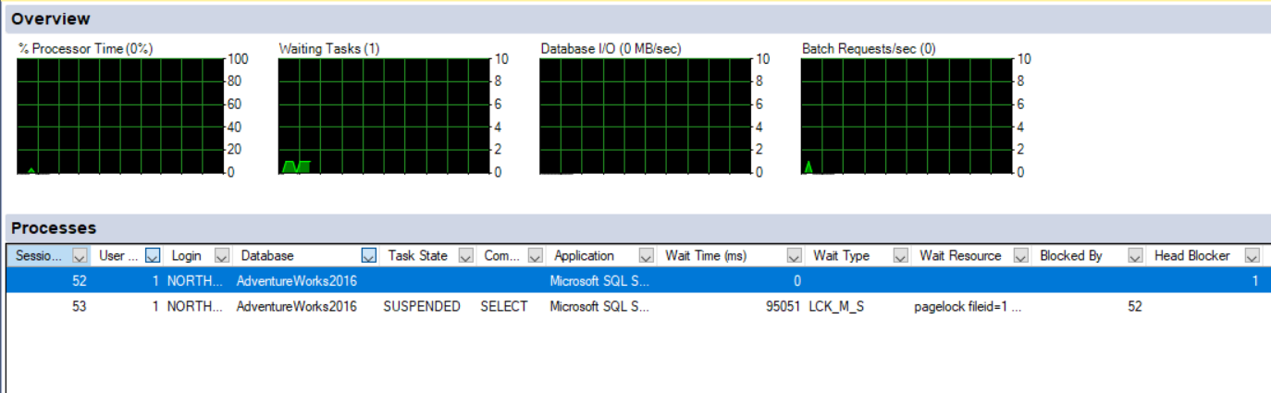
Activity Monitor

Slide 20
Demonstration

Slide 21
Dynamic Management Objects for Waits
Session CPU time and memory usage: sys.dm_exec_sessions
Status and session owner of request: sys.dm_exec_requests
Actual query text of waiting task: sys.dm_exec_sql_text
Active wait duration and type: sys.dm_os_waiting_tasks

Slide 22
Dynamic Management Objects for Waits
--Waiting tasks
SELECT w.session_id, w.wait_duration_ms, w.wait_type,
w.blocking_session_id, w.resource_description,
s.program_name, t.text, t.dbid, s.cpu_time,
s.memory_usage
FROM sys.dm_os_waiting_tasks as w
INNER JOIN sys.dm_exec_sessions as s
ON w.session_id = s.session_id
INNER JOIN sys.dm_exec_requests as r
ON s.session_id = r.session_id
OUTER APPLY sys.dm_exec_sql_text (r.sql_handle) as t
WHERE s.is_user_process = 1;
Notes:
10987B
1: SQL Server Architecture, Scheduling, and Waits

Slide 23
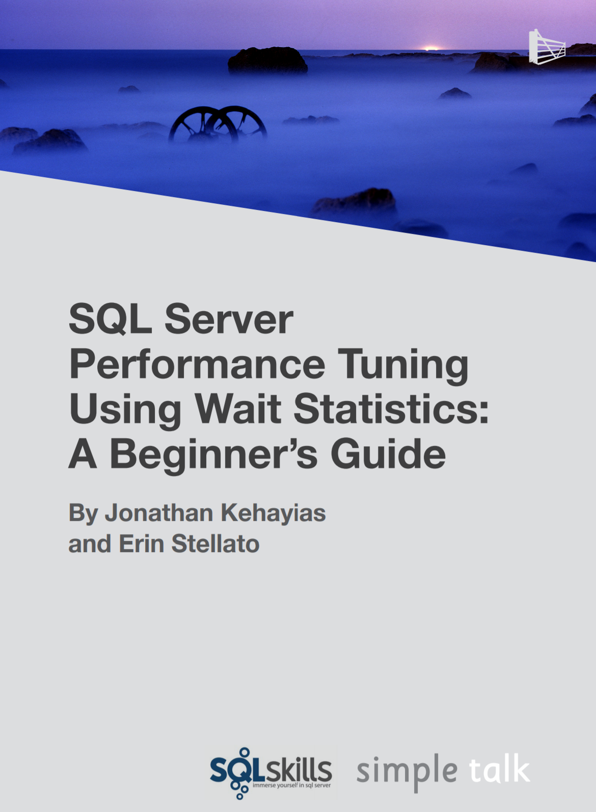
Troubleshooting Wait Types
Aaron Bertrand – Top Wait Types https://sqlperformance.com/2018/10/sql-performance/top-wait-stats
Paul Randal – SQL Skills Wait Types Library https://www.sqlskills.com/help/waits/
Notes:
10987B
1: SQL Server Architecture, Scheduling, and Waits

Slide 24
Demonstration

Slide 25
The Relational Engine John Deardurff

Slide 26
Query Process
Relational Engine
Resource Access
SQLOS
Storage Engine
Data Access
The Database Engine

Slide 27
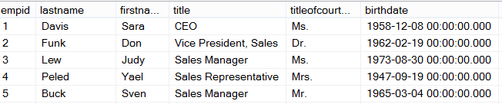
Ad Hoc Query
Stored Procedure
First Execution
or Recompile
Syntax
Parse
Execution Context
Resolve
(Binding)
Compile
Optimize
Estimated
Execution Plan
Procedure Cache
Compile
Compile
Actual
Run Time
Execute
Execute
Execute
Execute
SQL
SQL
Sets
Sets

Slide 28
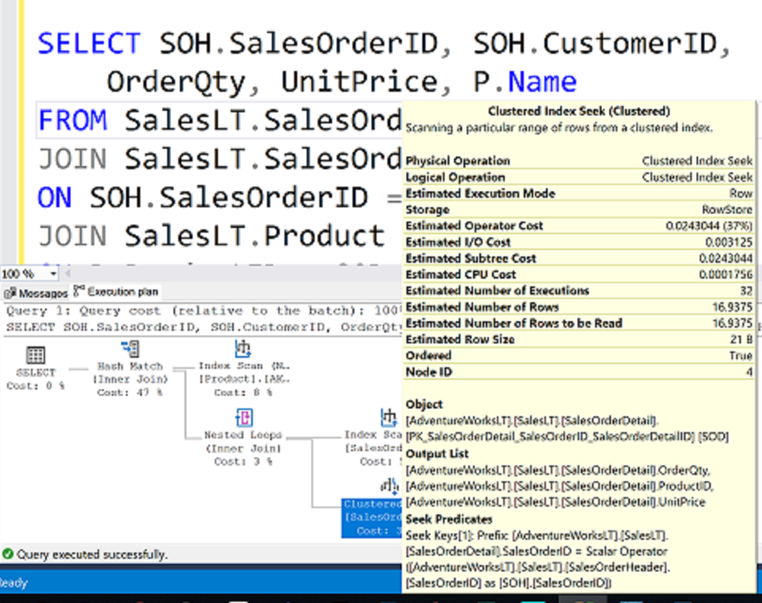
What is an Execution Plan?

Slide 29
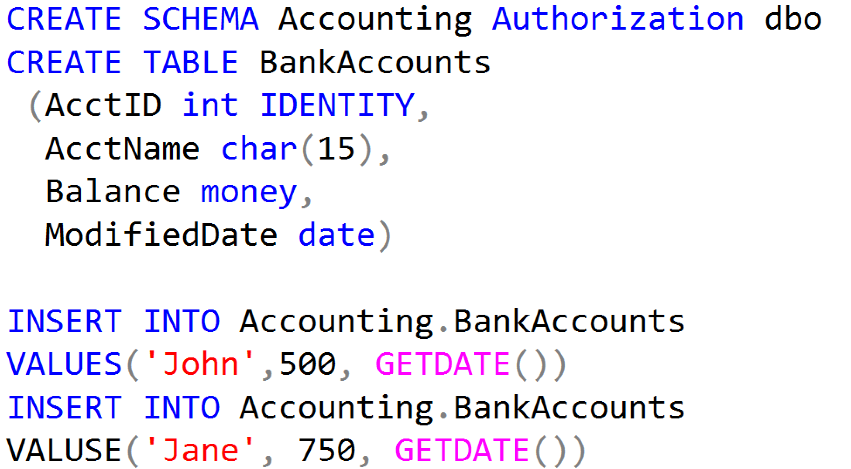
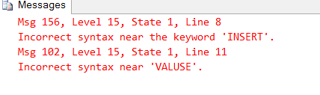
Code for Table Operators Demo

Slide 30
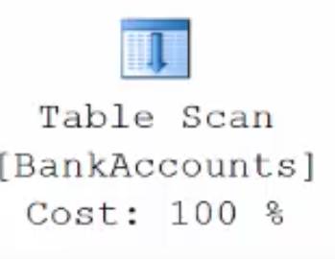
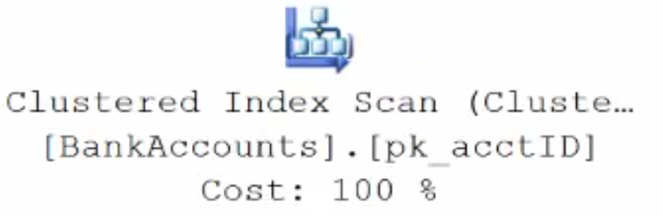
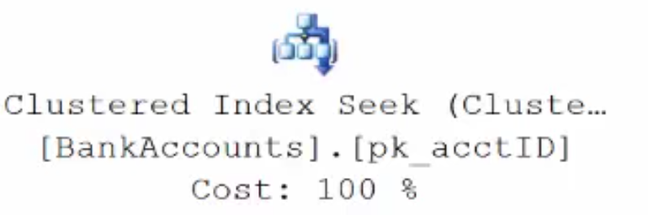
Execution Plan Table Operators
Data stored in a Heap is not stored in any order and normally does not have a Primary Key.
Clustered Index data is stored in sorted order by the Clustering key. In many cases, this is the same value as the Primary Key.
Using a WHERE statement on an Index could possibly have the Execution Plan seek the Index instead of scan.

Slide 31
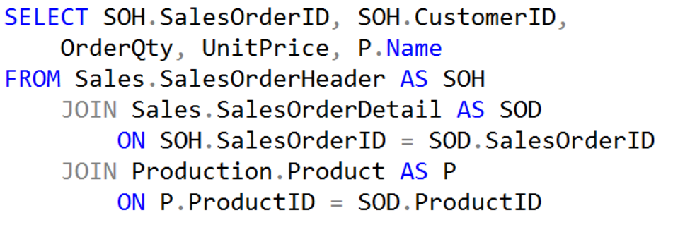
Execution Plan Join Operators (Code)

Slide 32
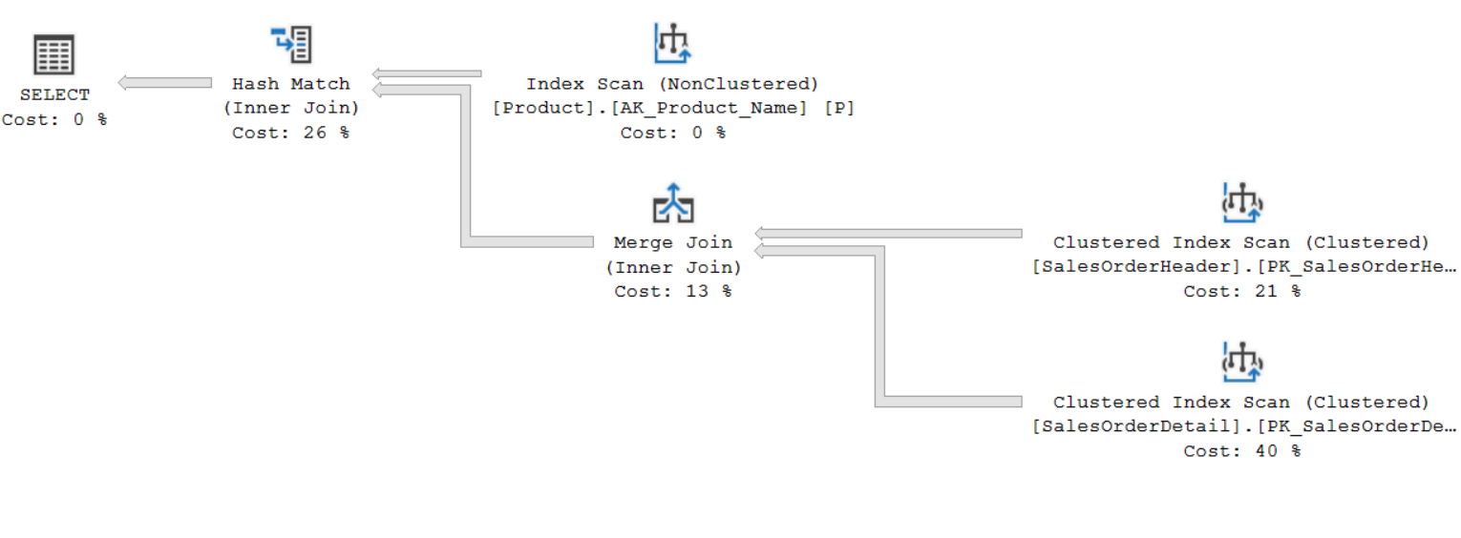
Execution Plan Join Operators (Plan)

Slide 33
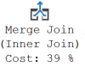
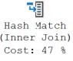
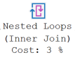
Execution Plan Join Operators
A Merge Join is useful if both table inputs are in the same sorted order on the same value.
A Hash Match is used when the tables being joined are not in the same sorted order.
A Nested Loop is use when a small (outer) table is used to lookup a value in a larger (inner) table.

Slide 34
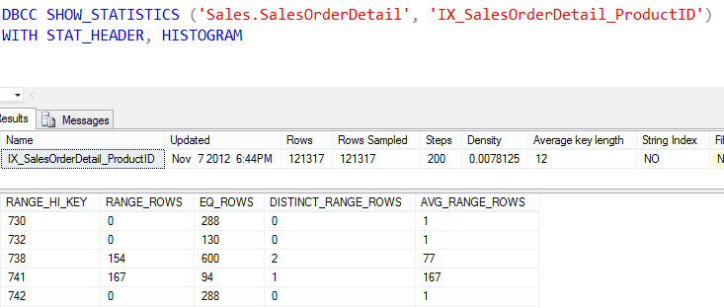
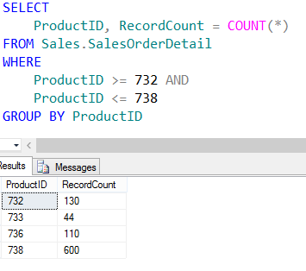
Showing Statistics

Slide 35
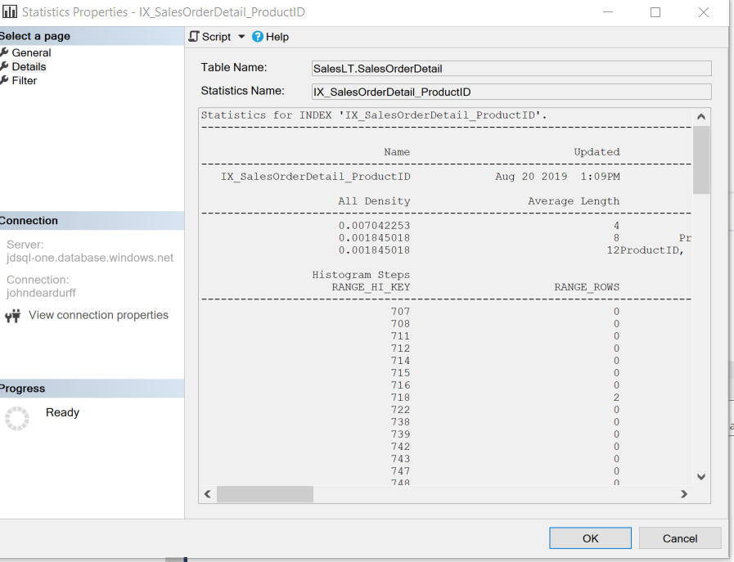
Cardinality Estimator and Statistics

Slide 36
The Storage Engine John Deardurff

Slide 37
How Data Is Stored in SQL Server
Data Row
Data Row
Data Row
Free Space
Data Row
Free Space
Data Row
Data Row
Data Row
Data Row
Free Space
Data Row
Free Space
Free Space
Free Space
Free Space
Data Row
Data Row
Data Row
Data Row
Data Row
Data Row
Free Space
Data Row
Data Row
Data Row
Data Row
Free Space
Data Row
Data Row
Free Space
Free Space
Primary Data File (.mdf)
Secondary Data File (.ndf)
Extent: Eight contiguous 8kb pages
Notes:
Provide an overview of how the data is stored on SQL Server. Describe each of the three data file types and the basic internal layout of the data files. Stress that the file extension .mdf is not mandatory to use but is highly recommended.
Describe the difference between uniform and mixed extents. Note that continued support for mixed extents adds complexity to the database engine for no real benefit. The size of an extent (64 KB) is so small that the original benefit from the mixed extent design is now irrelevant.
Briefly explain that all transactions are written to the log file using the WAL mechanism to ensure the integrity of the database in case of a failure and to support rollbacks of transactions. Explain that data changes occur in the buffer pool and are not written immediately to the data files.
Avoid discussing filegroups at this point, as they will be covered later.
20462C
3: Working with Databases and Storage

Slide 38
Rows stored in Data Pages
Page Header
(96 bytes)
Header contains Page Information such a Page Number and Page Type
Data Row 1
Data Row 2
Data Row 3
8060 bytes for Data Rows or Free Space
Free Space
Row Offset Array
Displays how far from beginning of page each row is located.

Slide 39
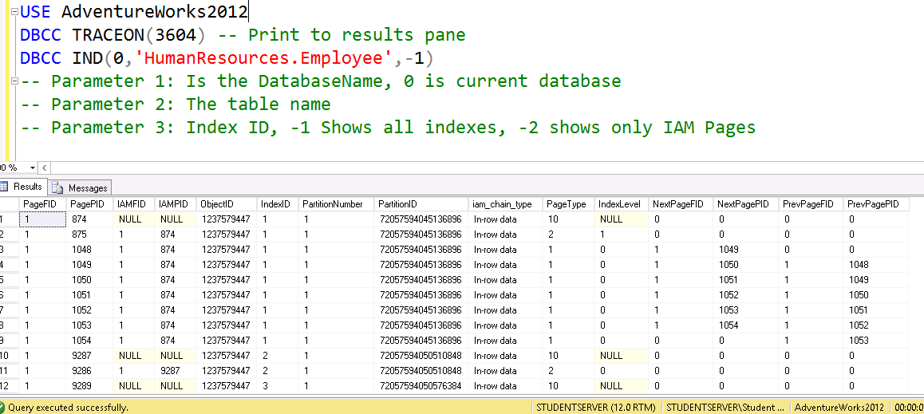
DBCC IND

Slide 40
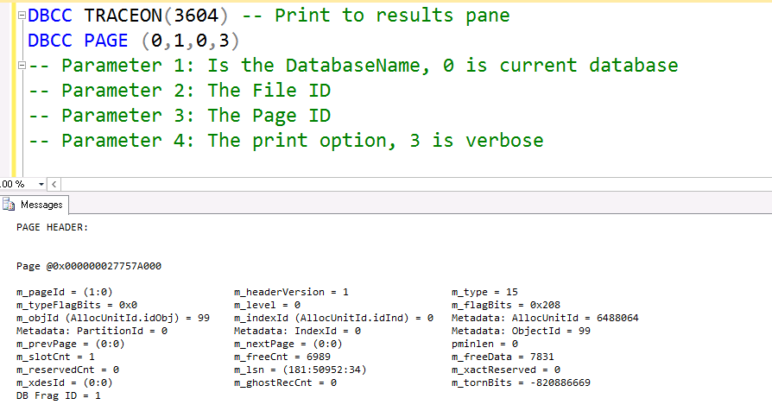
DBCC PAGE

